Slide 1
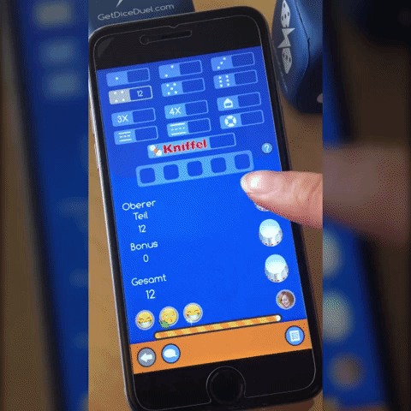

APPLICATION FUNDAMENTALS

Slide 2
Samiti Rahul (152907)
Naredla Gangavamshi (152851)
Aastha Verma (152537)
Jabbireddy Gireesha (152659)
Soumya Gupta (152915)

Slide 3
INTRODUCTION
TO APPLICATION

Slide 4
What is Application ?
An application is software designed to perform a group of functions, tasks, or activities for the benefit of the user.
Examples of an application includes word processor, web browser, media player etc.

Slide 5
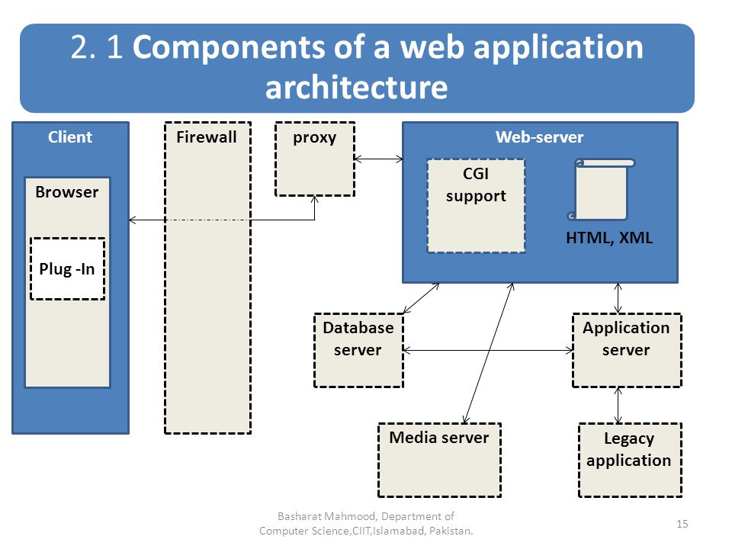
Components of Application

Slide 6
Application Lifecycle Management
ALM is the specification, design,
development and testing of a
application.
ALM covers the entire lifecycle from
the idea conception, through to the
development, testing, deployment,
support and ultimately retirement
of systems.

Slide 7
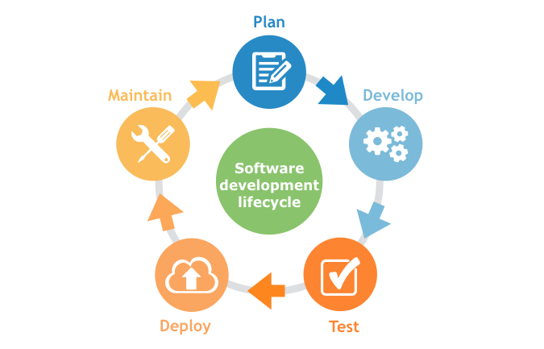

Slide 8
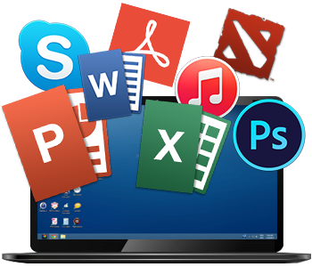
TYPES OF
APPLICATION

Slide 9
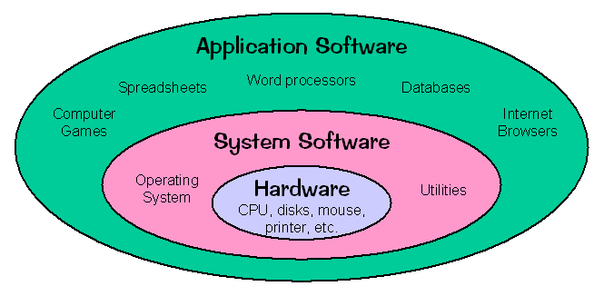
Software Classification
SYSTEM
SOFTWARE
APPLICATION
SOFTWARE

Slide 10
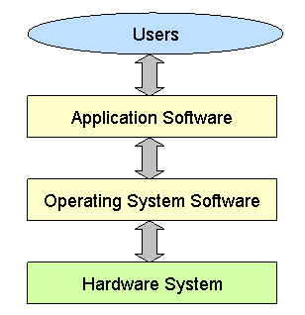
Software Hierarchy

Slide 11
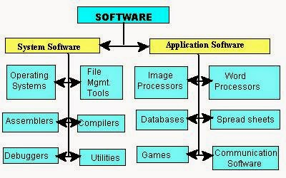
System and Application Software

Slide 12
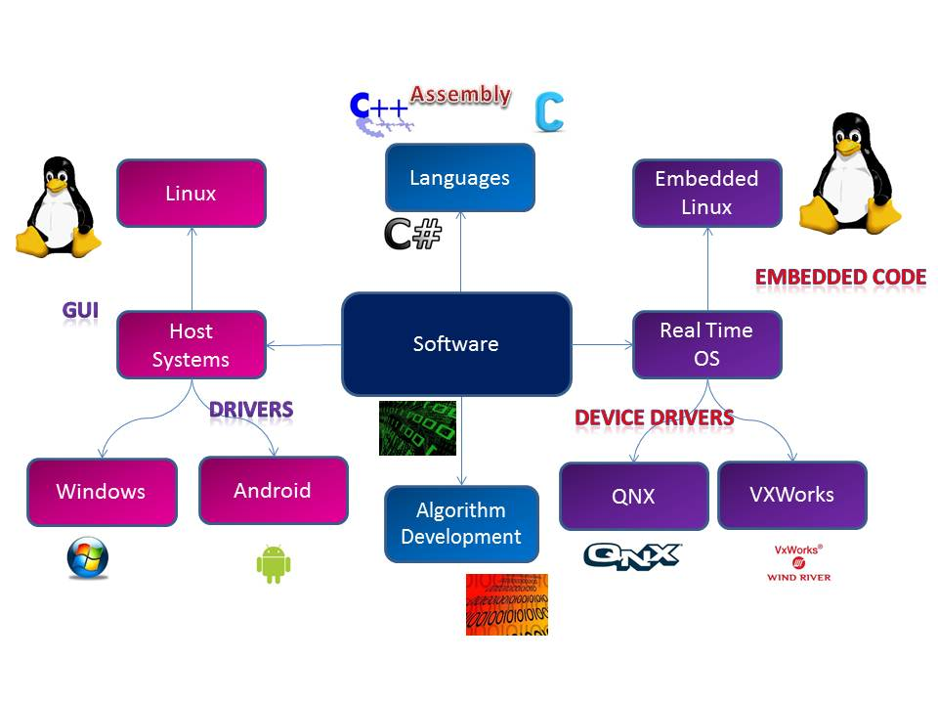
System Software Types

Slide 13
Application Software Types
Word Processing Software
Database Software
Spreadsheet Software
Multimedia Software
Presentation Software
Enterprise Software
Information Worker Software
Educational Software
Simulation Software
Content Access Software
Application Suites
Engineering & Product Development

Slide 14

Word Processing Software
EXAMPLES :
MS Word
Wordpad
Notepad

Slide 15



Database Software
EXAMPLES :
Oracle
MySQL
MS Access

Slide 16

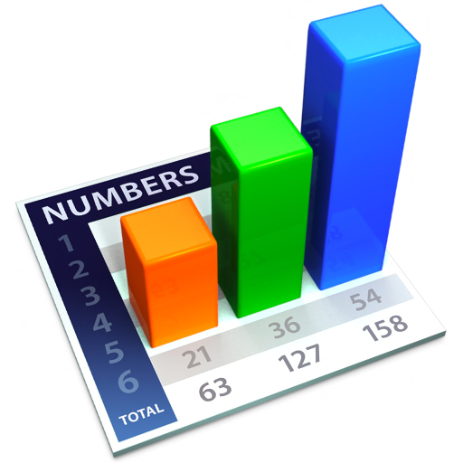

Spreadsheet Software
EXAMPLES :
Apple Numbers
Microsoft Excel

Slide 17



Multimedia Software
EXAMPLES :
iTunes
Media Player

Slide 18


Presentation Software
EXAMPLES :
Microsoft Power Point
Keynotes

Slide 19
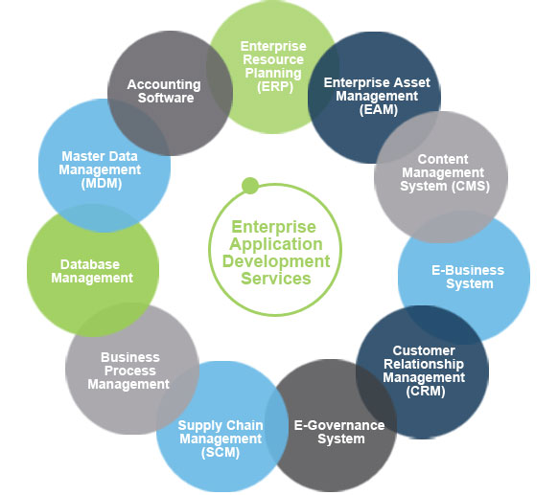
Enterprise Software
EXAMPLES :
Customer relationship
management system

Slide 20
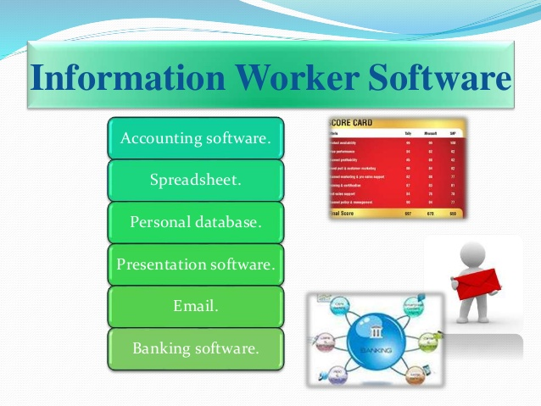
Information Worker Software
EXAMPLES :
Documentation tools
Resource management tools

Slide 21




Educational Software
EXAMPLES :
Dictionaries: Encarta, Britannica
Mathematical: MATLAB
Others: Google Earth, NASA World Wind

Slide 22
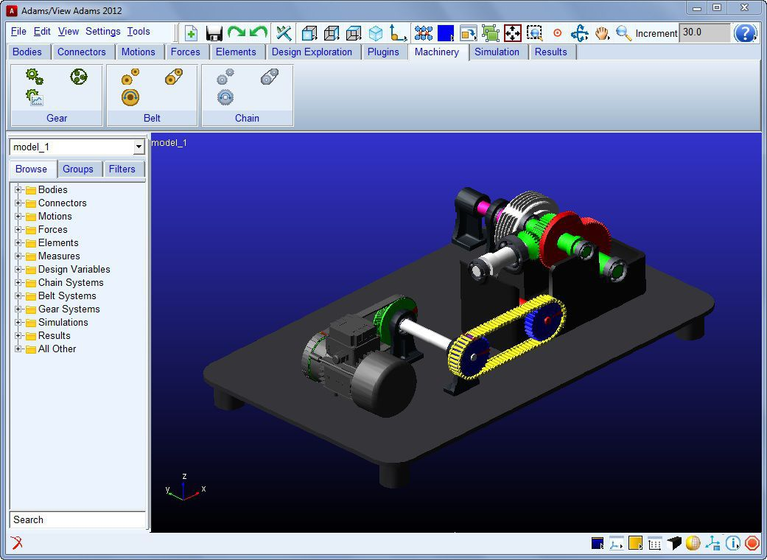
Simulation Software
EXAMPLES :
Flight and scientific simulators

Slide 23

Content Access Software
EXAMPLES :
Accessing content through media players, web browsers

Slide 24
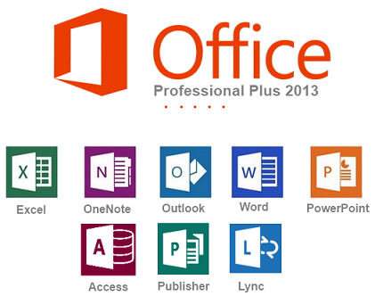
Application Suites
EXAMPLES :
OpenOffice
Microsoft Office

Slide 25

Software for Engineering and Product Development
EXAMPLES :
IDEs

